Slide 1
Project 2: To-Do List Application
Simon Powell

Slide 2
Approach
SOLID Principles
Updated documentation
Strong focus on Testing
Agile approach

Slide 3
Journey
Technologies learnt:
Mockito
Selenium
JavaScript
HTML
CSS
Applications learnt:
Visual Studio Code
Spring

Slide 4
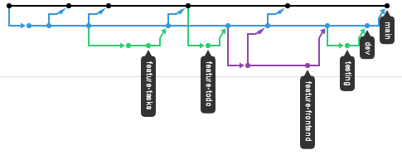
CI Pipeline
Version Control System: Github
DevOps: Java Language
Testing: Junit and Mockito

Slide 5

Testing
ToDoProject coverage: 77.4%
src/main/java coverage: 63.9%

Slide 6
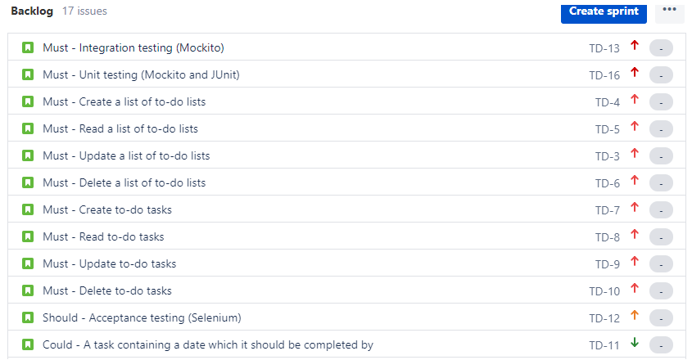
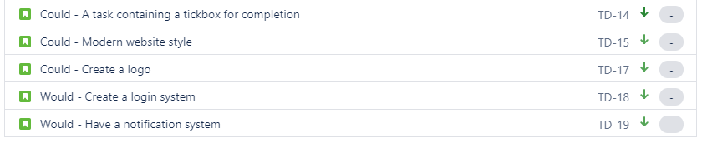
Use of Jira
Using the MoSCow approach
Added prioritisation and labels to keep track of functionality, optionals, design and testing

Slide 7
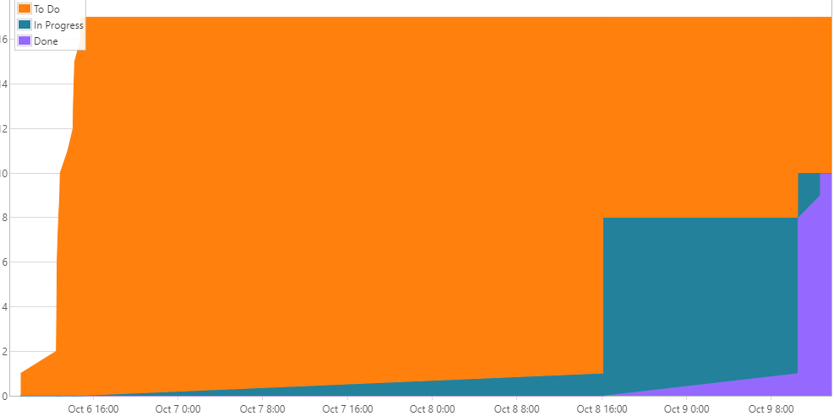
Cumulative Flow Diagram

Slide 8
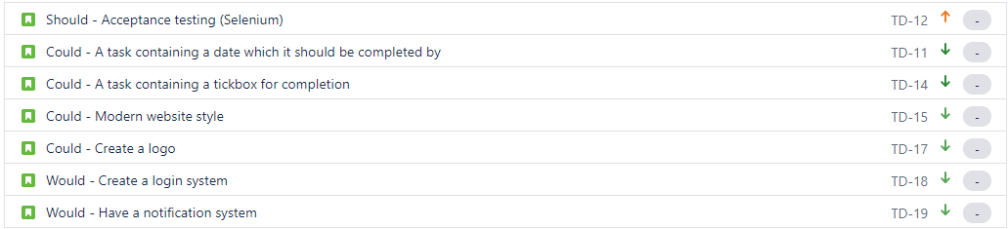
Sprint Review
Completed:
Backend for ToDoProject
Unit and integration testing for controllers and services
Incomplete:
Selenium Testing
Frontend

Slide 9
Sprint Retrospective
What went well:
Unit and integration testing for controllers and services
Improvement:
Time management for frontend and Selenium testing
Frontend interface and functionality

Slide 10


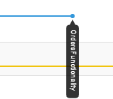
Project Reflection
Significant improvement in GitHub usage
Significant improvement needed for time-management and frontend knowledge

Slide 11
Conclusion
This project allowed me to understand my strengths in backend while knowing that I need to improve on the front end
Allowed me to understand what I knew and what I needed to improve overall
In the future, I want to revise JavaScript, HTML, CSS and Selenium in depth to make sure I do not make the same mist with frontend time-management as I have done with this project

Slide 12
Questions?

